Slide 1




Set up business plan
Start up plan
Start -Up Business Plan
Business
Name: Aiko
Practice solution

Slide 2
Project name: Aiko name: Abhiyant Singh
exploring farm-to-market possibilities
There is a growing Demand for the fresh, clean Food
practices to finance and structure
Practice solution

Slide 3

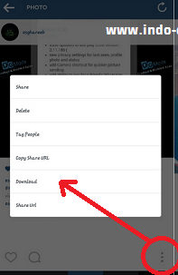

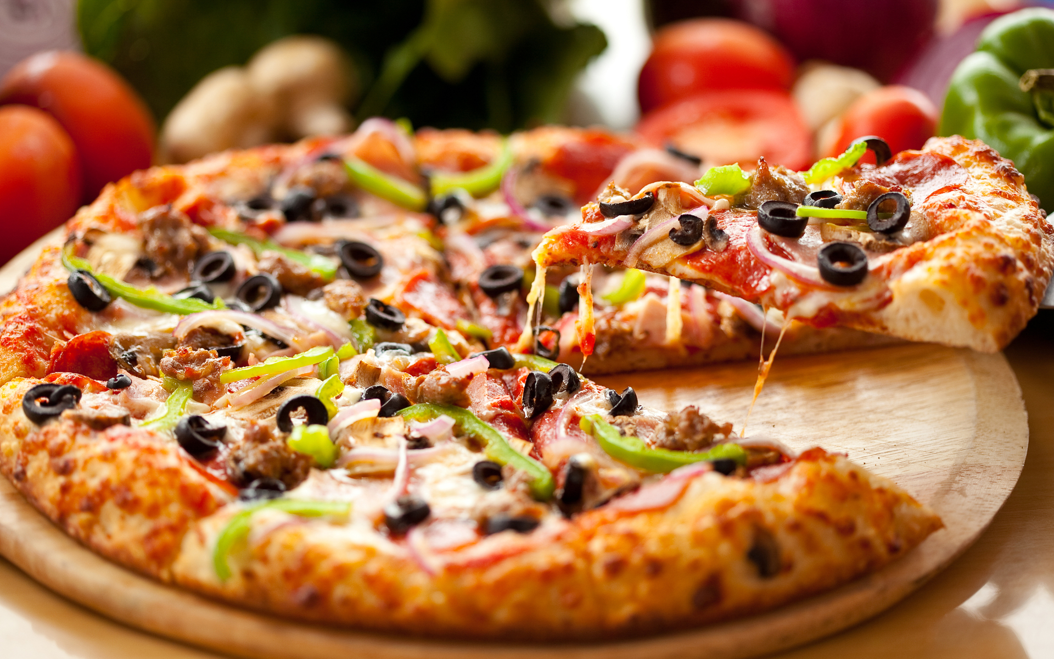
Buy like comment
report
create order to chef professional
amount of calories, nutrients
dm
Rs.100 20 10
Follow
Location : indore, bada bagad
Tag : pizza
uploaded 1 hours ago

Slide 4
Project description
Increasing sales farming is difficult
farmers need to break into more markets.
Farmers learn opportunities for selling
most people buy food from grocery stores
Practice solution

Slide 5
Project goal
Improved nutrition, in children and women, by nutrition education
increased consumption of a diversified diet of vegetable and fruits
Practice solution

Slide 6
Evaluation strategy
We start from Indore than India, village
Sales promotions campaigns
Identify performance gaps in the sales goals and actual
Practice solution

Slide 7
Conclusions and implications
effective food safety on science.
current governing food safety regulation and management must revised.
Practice solution

Slide 8
Problem
a
chefs working at home, produce tasty food for people, income for themselves and tax revenue for cities and states.
b
It were legal to sell home-cooked food.
Practice solution

Slide 9
solution
This business will not survive without tracking system. To maintain profitability, inventory needs to be rigorously managed and maintained.
Biggest challenge: Alcohol/liquor tracking and management
Solution
Practice solution

Slide 10
advantage
Saves money
Saves time
Brings family together
Avoid food allergies
Practice solution

Slide 11
CHANNELS
Face book
INSTAGRAM
Content marketing
Target A Specific Demographic
Food Is Creative
you tube
Linkedln ads
Food Is Social
Words of mouth
Brand trust
Brand loyalty
Practice solution

Slide 12
customer
Offer More-Expensive Items
Make Suggestions
Offer Specific Items
Practice solution

Slide 13
cost
Obtain other permits (cost: more than rs.15,997)
Buy equipment and other thinks (cost: roughly rs.3,99,930)
Get documents for paying sales taxes (cost: free)
Find the right product and name (cost: years of experience)
Practice solution

Slide 14
Contact information
Mobile no: 9340221896
Address : symbiosis university of applied sciences (suas) indore, madhya pradesh
Instagram :@abhiyantsingh
Email address: abhiyantsingh123@gmail.com
Wix : https://abhiyantsingh123.wixsite.com/abhiyantsinghelixir
Reference literature
http://smallbusiness.chron.com
https://extension2.missouri.edu
Thanks you

